Slide 1
B2.1.3 Describe how programs use common
exception handling techniques

Slide 2
Starter Activity - Prior Learning
Solve the given problems from the learning menu :
Create a variable inside a function, with the same name as the global variable
If you want to specify the data type of a variable, this can be done with casting. Explain with an example
Write a program to display the list of flowers of your choice
Write a program to display the tuple of any three football players

Slide 3
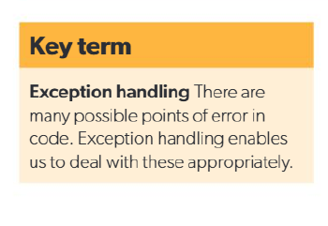
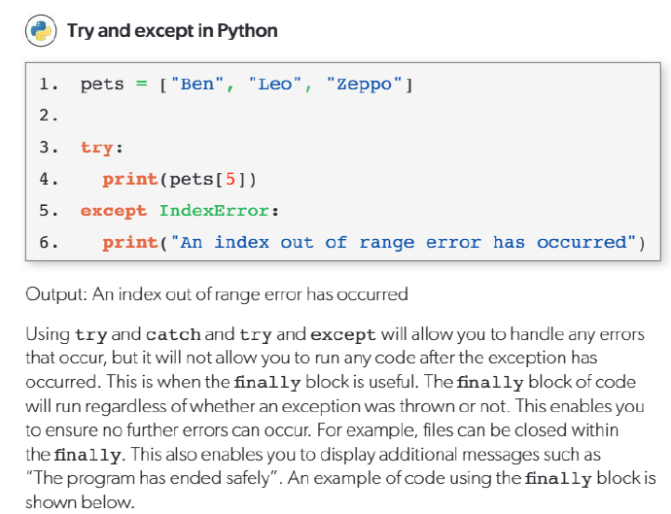
Exception Handling in Python
In Python, exception handling is used to manage errors that occur during program execution, preventing the program from crashing. This is done using the try and except blocks. Code that may cause an error is placed inside the try block, and if an error occurs, the program moves to the except block to handle it gracefully. For example, when trying to access a list element that does not exist, instead of breaking the program, Python can display an error message or take corrective action. Exception handling makes programs more reliable by managing unexpected input, unavailable resources, or logic errors effectively.

Slide 4
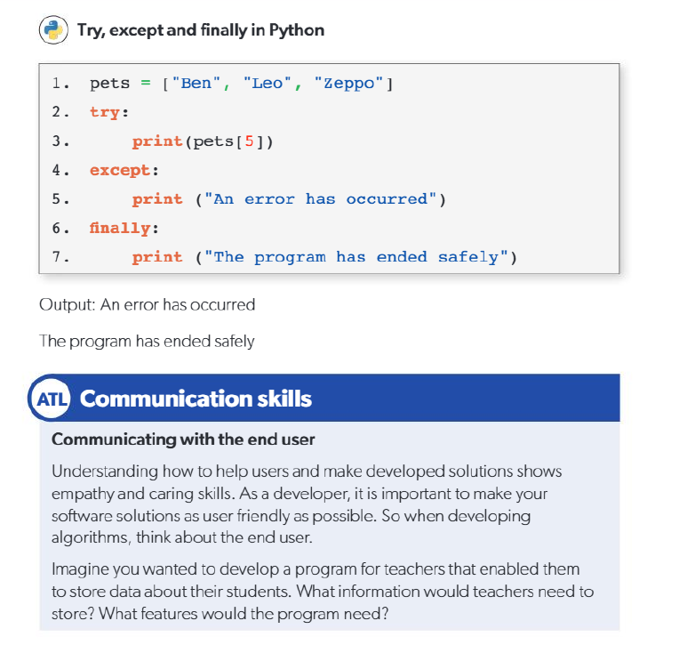


Slide 5
Exam Style Questions Practice
Define the term exception handling in programming.
Identify two types of errors that can be handled using exception handling techniques.
State the purpose of using the try and except blocks in Python.
Write one real-life example of when a program may need exception handling.

Slide 6
Challenging task - 10 mins
Consider the following Python code:
numbers = [10, 20, 30]
try:
print(numbers[5])
except:
print("Index out of range error")
(a) Identify the type of error that may occur.
(b) Explain how the except block prevents the program from crashing.
Discuss why exception handling is important when dealing with user input in programs. Provide one example in Python.

Slide 7
Plenary
Evaluate the importance of exception handling in software development. In your answer, consider:
User experience
Program reliability
Debugging and testing

